Slide 1

What Is Motivation?
Direction
Intensity
Persistence
© 2007 Prentice Hall Inc. All rights reserved.
Notes:
Motivation is the process that accounts for an individual’s intensity, direction, and persistence of effort toward the attainment of a goal. Intensity is concerned with how hard a person tries. This is the element most of us focus on when we discuss the topic of motivation. However, unless effort is channeled in a direction that benefits the organization, high intensity is no guarantee of favorable job-performance outcomes. Quality of effort, therefore, is just as important as intensity of effort. Finally, persistence (how long a person can maintain effort) is important. A motivated person stays with a task long enough to achieve his or her goal.

Slide 2
What is Motivation?
Motivation
The processes that account for an individual’s intensity, direction, and persistence of effort toward attaining a goal.
Key Elements
Intensity: how hard a person tries
Direction: toward beneficial goal
Persistence: how long a person tries
© 2007 Prentice Hall Inc. All rights reserved.

Slide 3
Hierarchy of Needs Theory (Maslow)
Hierarchy of Needs Theory
There is a hierarchy of five needs—physiological, safety, social, esteem, and self-actualization; as each need is substantially satisfied, the next need becomes dominant.
    Self-Actualization
    The drive to become what one is capable of becoming.
© 2007 Prentice Hall Inc. All rights reserved.

Slide 4
Maslow’s Hierarchy of Needs
Lower-Order Needs
Needs that are satisfied externally; physiological
and safety needs.
Higher-Order Needs
Needs that are satisfied
internally; social, esteem,
and self-actualization
needs.
Self
Esteem
Social
Safety
Physiological
E X H I B I T 6–1
© 2007 Prentice Hall Inc. All rights reserved.

Slide 5
Assumptions of Maslow’s Hierarchy
Movement up the Pyramid
Individuals cannot move to the next higher level until all needs at the current (lower) level are satisfied.
Individuals therefore must move up the hierarchy in order
Maslow Application:
A homeless person
will not be motivated to
meditate!
© 2007 Prentice Hall Inc. All rights reserved.

Slide 6
McGregor’s Theory X and Theory Y
Theory X
Traditional theory of human behaviour
Management is responsible for organising-man,material,equipment and people-in the interest of economic end
With respect to people-this is the process of directing, motivating, controlling, modifying their behavior to fit the needs of organisation.
Without this active intervention- they would be passive
he works as little as possible
Inherently self-centred, indifferent to organisational needs
Resistant to change.
© 2007 Prentice Hall Inc. All rights reserved.

Slide 7
McGregor’s Theory X and Theory Y
Theory Y
The expenditure of physical and mental efforts in work is natural as play or rest. The average human being does not inherently dislike work
External control and threat of punishments are not the only means to aline their behaviour with org. ‘s objectives. Man will exercise self direction and self control.
Commitment to objectives is a function of reward associated with their achievements.
Average human being under proper condition learns not only to accept , but to seek responsibilities.
They exercise high degree of imagination, ingenuity and creativity to solve organisational problems.
© 2007 Prentice Hall Inc. All rights reserved.

Slide 8
Having Little Ambition
Theory X
Managers See Workers As…
Disliking Work
Avoiding Responsibility
Self-Directed
Theory Y
Managers See Workers As…
Enjoying Work
Accepting Responsibility
© 2007 Prentice Hall Inc. All rights reserved.
Notes:
Douglas McGregor said that managers hold one of two sets of assumptions about human nature: either Theory X or Theory Y. Seeing people as irresponsible and lazy, managers who follow Theory X assume the following:
1. Employees inherently dislike work and will try to avoid it.
2. Since employees dislike work, they must be coerced, controlled, or threatened to achieve goals.
3. Employees avoid responsibilities and seek formal direction, if possible.
4. Most workers place security above all other work-related factors and will display little ambition.
Since they see people as responsible and conscientious, managers who follow Theory Y assume the following:
1. Employees can view work as being as natural as rest or play.
2. When committed to their objectives, people will exercise self-direction and self-control
3. The average person can learn to accept, even seek, responsibility.
4. Many workers besides managers have innovative decision-making skills.
No hard evidence confirms that either set of assumptions is universally true. It is more likely that the assumptions of Theory X or Theory Y may or may not be appropriate, depending on the situation at hand.

Slide 9
Ouchi’s Theory Z
Suggested five broad features
Trust
Strong bond between organisation and employees
Emloyee involvement
No formal structure
Coordination of human beings
© 2007 Prentice Hall Inc. All rights reserved.

Slide 10
Carrot and Stick approach to motivation
Based on the ‘Principles of Reinforcement’
Comes from the old story that the best way to make donkey move is to put the carrot out in front of him or jab him with a stick from behind.
© 2007 Prentice Hall Inc. All rights reserved.

Slide 11
Herzberg’s Two-Factor Theory
Bottom Line: Satisfaction and Dissatisfaction are not Opposite Ends of the Same Thing!
Hygiene Factors:
Salary
Work Conditions
Company Policies
Separate constructs
  Hygiene Factors---Extrinsic & Related to Dissatisfaction
  Motivation Factors---Intrinsic and Related to Satisfaction
Motivators:
Achievement
Responsibility
Growth
© 2007 Prentice Hall Inc. All rights reserved.

Slide 12
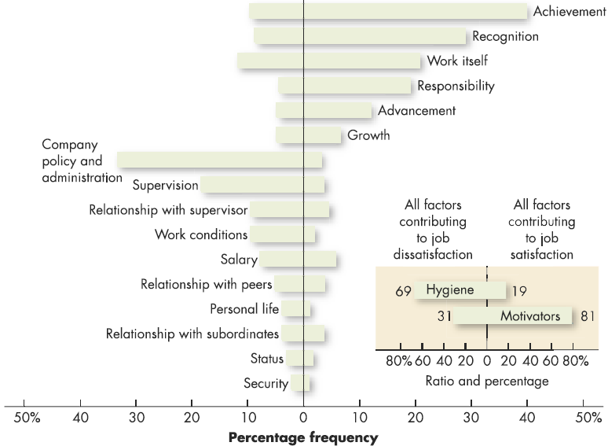
Comparison of Satisfiers and Dissatisfiers
Factors characterizing events on the job that led to extreme job dissatisfaction
Factors characterizing events on the job that led to extreme job satisfaction
Source: Reprinted by permission of Harvard Business Review. An exhibit from One More Time: How Do You Motivate Employees? by Frederick Herzberg, September–October 1987. Copyright © 1987 by the President and Fellows of Harvard College: All rights reserved.
E X H I B I T 6–2
© 2007 Prentice Hall Inc. All rights reserved.

Slide 13
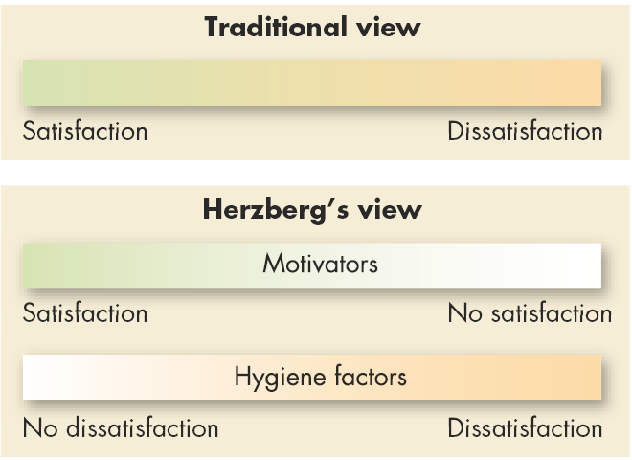
Contrasting Views of Satisfaction and Dissatisfaction
E X H I B I T 6–3
© 2007 Prentice Hall Inc. All rights reserved.

